Slide 1


ENGINEERING SOLUTIONS AND SITE SUPPORT

Slide 2

ENGINEERING SOLUTIONS AND SITE SUPPORT

Slide 3
What We Do
HTS GROUP is an Engineering Solution provider specialising in delivering quality and compliant solutions for our core activities, Process, Process Safety and Electrical, Control & Instrumentation (EC&I) systems and solutions.

Slide 4

How We Do It
HTSsafety | Regulatory & Process / Machinery Safety
HTSControls | System Engineering & Build (PLC,HMI,SCADA, System build)
HTSAutomation | E&I Engineering & Design
HTSSite Services | Site Installation & Maintenance

Slide 5
How We Deliver It
CES
CONTRACT Engineering Solutions
HTS’ unique six stage programme for site-based operational projects and maintenance activities to run on time, on cost, on quality and within scope
PES
PROJECT Engineering Solutions
Through our “one stop shop” solution we are able to put into practice an engineered solution that is suitable and fit for purpose
Compliance
Regulatory, Engineering, Testing & Inspection
ATEX (BS EN 60079)
Electrical Testing & Inspections (BS 7671)
Functional Safety (BS EN 61508 / 61511)
DSEAR & Explosion Protection
HAZoP & LOPA

Slide 6
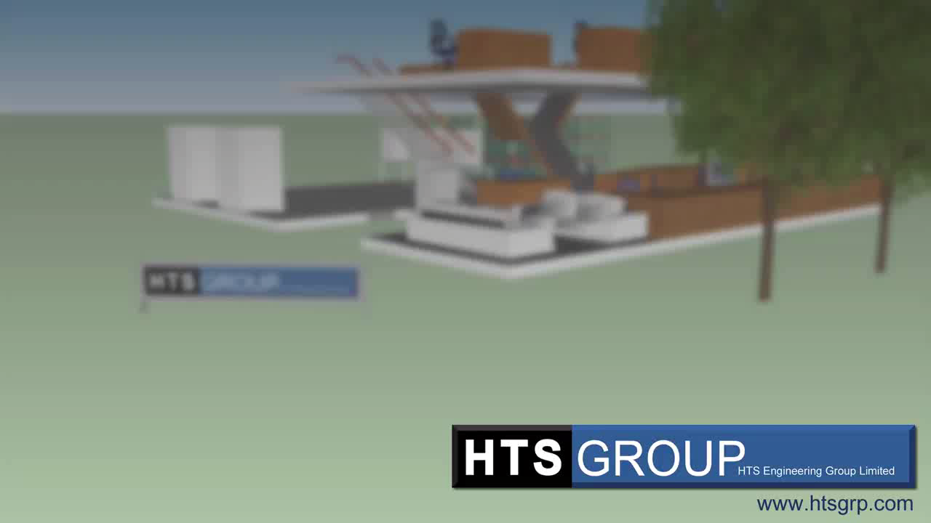
Where We Do
It
Facilities
General Engineering Office
PLC / SCADA Development Area
Workshop
Instrument and Equipment Set-up

Slide 7









Who We Do It For

Slide 8

S.P.I.N.
Situation?
Problem?
Implication?
Need-payoff?
Notes:
Situation Questions deal with the facts about the buyers existing situation.
Problem Questions ask about the buyer's pain and focus the buyer on this pain while clarifying the problem, before asking implication questions. . These give Implied Needs.
Implication Questions discuss the effects of the problem, before talking about solutions, and develop the seriousness of the problem to increase the buyer's motivation to change.
Need-Payoff Questions get the buyer to tell you about their Explicit Needs and the benefits your solutions offers, rather than forcing you to explain the benefits to the buyer. Getting the buyer to state the benefits has greater impact while sounding a lot less pushy. What these questions do is probe for explicit needs

Slide 9


